Slide 1
Datacrowd
First Milestone Presentation
Tsampras Konstantinos Papoutsas Georgios

Slide 2




Mission Statement
Crowd Monitoring in Public Spaces
Problems:
Overcrowding
Disease Transmission Risk [Hospitals, Public Spaces]
Air Quality Considerations [Closed areas, Shops etc.]
Personal Scheduling
Avoid High Traffic Hours or Spaces
Visit recreational spaces during peak popularity
Convoluted Personal Time Schedules
Resource Management
Ineffective Employee timetables
Public Transport Dispatching
Marketing in Public Spaces
Long Term Planning
Urban Planning
Business Decisions [Store Locations, Amenities Planning]

Slide 3

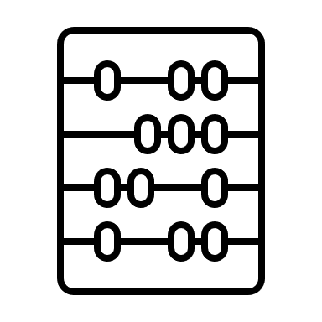

Solutions
Inform Public for better decision making
Real time data and Predictions [heatmaps and graphs]
Suggestions and Alerts
Monitoring Tools for Authorities & Businesses
Crowd Overview
Insights for better resource allocation
Alerting and notifying
Tools for Long Term Planning
Insights about infrastructure planning in popular areas
Effectiveness evaluation for measures taken

Slide 4
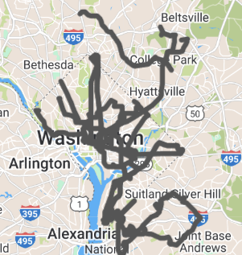
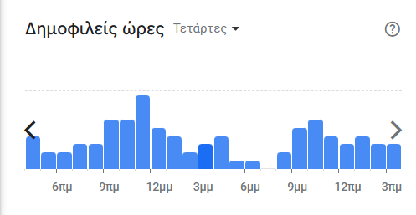
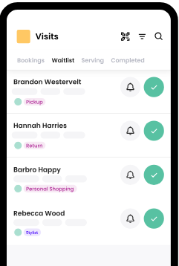
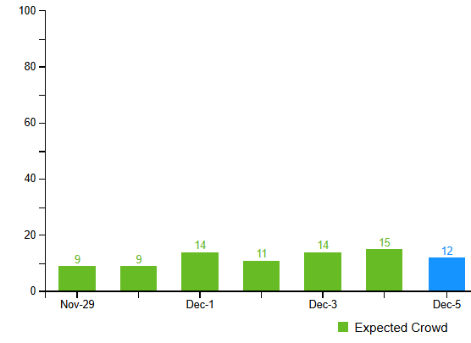
Other solutions
Features/App | Public Transit apps | Avoid crowds | Waitwhile | Google Places API | Foursquare | Datacrowd
Crowd Prediction |  | X | X | X | X | X
Multi-source model |  |  |  |  |  | X
Business & Authorities Insights |  |  | X | X | X | X
Commute Scheduling | X |  |  | X | X | X
https://www.wmata.com/service/status/
https://avoid-crowds.com/
https://waitwhile.com/
https://developers.google.com/maps/documentation/places/web-service
https://foursquare.com/

Slide 5



Data sources
Collect data from:
Traffic in public networks (WiFi4EU, Eduroam)
Environmental sensors (CO₂, Temperature, Humidity)
Google places API
Camera feeds in public places
Bluetooth sensors in public places

Slide 6
Requirements
Target audience
Access to traffic in public networks
Access to the Places API
Sensors (CO₂, Temperature, Humidity) - 169€
IP Cameras - 30€
Raspberry Pi - 70€
Bluetooth traffic sensors
Citizens
Students
Users of Public Transport and Services
Tourists
Authorities and Businesses
Educational Institutions
Municipal Authorities
Public Transport Authorities
Private Businesses
Groups of Businesses
https://developers.google.com/maps/documentation/places/web-service/overview
https://mclimate.eu/products/mclimate-co2-sensor-notifier-lorawan?variant=47859023806796
https://www.skroutz.gr/c/688/kameres-parakolouthisis/f/916690/IP.html
https://www.skroutz.gr/s/19212716/Raspberry-Pi-4-Model-B-4GB.html
https://www.researchgate.net/publication/272071234_Bluetooth_Sensors_for_Vehicular_Traffic_Monitoring

Slide 7
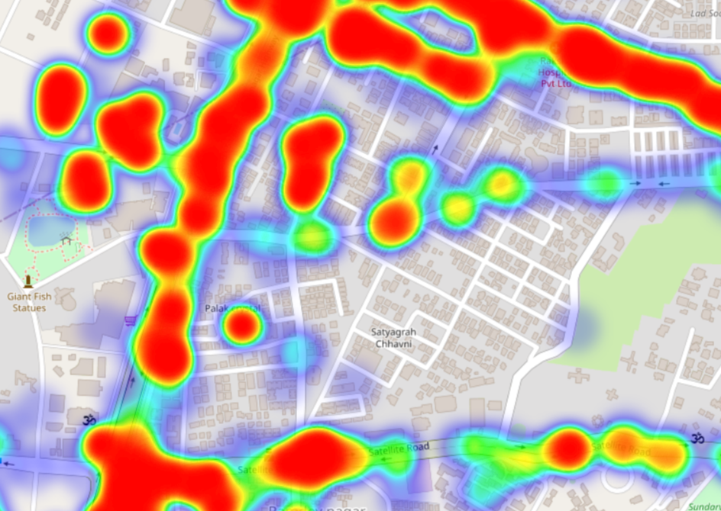
Unique value proposition
By using 5 data sources, we can analyze and combine the sources in order to create a single crowd predicting model that can provide real-time and more accurate heatmaps about the actual congestion in popular areas.
In contrast to other solutions, our service will provide data about every place in a city and not just certain areas (Public Transport or specific Businesses).

Slide 8
Thank you for your time!

